Slide 1

Microsoft
AI TOKENOMICS / EXECUTIVE BRIEF
Make AI spend
an executive decision
Fabric + Foundry tokenomics
For a global semiconductor enterprise
Visibility → governed action → billed savings
Proposed architecture and business case • September 2026
Michael Yaacoub | Sr Solution Engineer
01
Notes:
Original proposed architecture and illustrative economics for a Micron-like global semiconductor enterprise. Company valuation is not a sizing input. No assertion of Micron spend, adoption, or market capitalization. Repository describes a cross-cloud AI cost analytics concept. It has not been deployment-tested here. https://github.com/csdmichael/FabricIQ-FoundryIQ-CostOps-Docs
The wafer image is generated illustrative art. No official customer imagery is implied.
Header uses an editable reconstruction of the Microsoft four-square mark and wordmark, not a supplied official logo asset.
Visual inspection note: The four Microsoft logo colours are intentional branding, not extra data-series colours. The measured card/text/arrow left edges include diagram routing lanes and card insets. Mixed-size node paragraphs and the engine's trailing blank paragraph can inflate estimated text-fit warnings; actual line placement is checked in the final rendered slides. The business cover uses a deliberate flat text panel beside a photograph.

Slide 2
Microsoft
AI TOKENOMICS / EXECUTIVE BRIEF
Turn visibility into measurable savings
$1.05m
$12.65m
$10.32m
Net savings / month
Annual net run-rate
Year-one net benefit
$1,054,400 at steady state
$12,652,800 at steady state
$10,321,200 after ramp + setup
Planning case: $5m/month in-scope AI consumption
Approve only quality-safe optimizations. Finance validates realized savings against invoices.
Illustrative planning assumptions — not Micron spend, Microsoft pricing quotes, or guaranteed savings
Source: illustrative model; exact assumptions and figures on slide 14.
Michael Yaacoub | Sr Solution Engineer
02
Notes:
Illustrative planning assumptions — not Micron spend, Microsoft pricing quotes, or guaranteed savings. Base S=$5,000,000/month. Gross reduction = 1−0.88×0.92×0.95 = 23.088%; gross $1,154,400/month; ongoing platform $100,000/month; net $1,054,400/month. Annual run-rate net $12,652,800. Year one = 10.5×gross−12×ongoing−$600,000 setup = $10,321,200. Productivity and avoided incidents are not cash savings in this model. These are hypotheses, not measured outcomes.
Header uses an editable reconstruction of the Microsoft four-square mark and wordmark, not a supplied official logo asset.
Visual inspection note: The four Microsoft logo colours are intentional branding, not extra data-series colours. The measured card/text/arrow left edges include diagram routing lanes and card insets. Mixed-size node paragraphs and the engine's trailing blank paragraph can inflate estimated text-fit warnings; actual line placement is checked in the final rendered slides. The business cover uses a deliberate flat text panel beside a photograph.

Slide 3

Microsoft
AI TOKENOMICS / EXECUTIVE BRIEF
Match AI economics to business outcomes
Engineering copilots
Right-size routine requests; preserve code quality and latency.
Manufacturing troubleshooting
Spot retry loops and anomalous spend; protect critical response quality.
Supply-chain analytics
Forecast consumption by BU; prioritize value over token volume.
Source: proposed semiconductor use cases; not claims about Micron deployments.
Michael Yaacoub | Sr Solution Engineer
03
Notes:
Proposed decisions for a global semiconductor enterprise. No production deployment or actual benefit is claimed. Unify bills and usage to compare cost per approved business outcome; do not use token reduction alone as a quality metric. Semiconductor macro image is generated illustrative art.
Header uses an editable reconstruction of the Microsoft four-square mark and wordmark, not a supplied official logo asset.
Visual inspection note: The four Microsoft logo colours are intentional branding, not extra data-series colours. The measured card/text/arrow left edges include diagram routing lanes and card insets. Mixed-size node paragraphs and the engine's trailing blank paragraph can inflate estimated text-fit warnings; actual line placement is checked in the final rendered slides. The business cover uses a deliberate flat text panel beside a photograph.

Slide 4
Microsoft
AI TOKENOMICS / EXECUTIVE BRIEF
Normalize once. Compare across providers.
Five providers
Bedrock • Vertex
Foundry • OpenAI • Anthropic
Raw landing
Blob snapshots
Normalize
Cosmos • user hash
Fabric layers
Bronze / Silver
Log Analytics telemetry joins the governed ingestion pipeline.
Price provenance
Effective-dated cards
History + snapshots
ML outputs
Insights + model-run ledger
Gold tokenomics
ml.tokenomics_usage_fact
Price history enriches Gold facts; retain provenance and reconcile normalized usage to bills.
Source: repository overview + proposed telemetry ingestion; see notes.
Michael Yaacoub | Sr Solution Engineer
04
Notes:
Repository overview: Five-provider usage is normalized into Fabric facts with rate provenance and ML outputs. https://github.com/csdmichael/FabricIQ-FoundryIQ-CostOps-Docs
Gold fact: ml.tokenomics_usage_fact. Effective-dated table model_price_history and provenance model_price_snapshot. ML writes ml.* output tables including ml.ml_insight_fact and ml.model_run_ledger. The pricing enrichment relationship is described in the caption to keep connector lanes free. Log Analytics ingestion to Fabric is proposed and needs design of export/collection, cadence, schema, retention, and reconciliation. Repository claims were not production-validated.
Header uses an editable reconstruction of the Microsoft four-square mark and wordmark, not a supplied official logo asset.
Visual inspection note: The four Microsoft logo colours are intentional branding, not extra data-series colours. The measured card/text/arrow left edges include diagram routing lanes and card insets. Mixed-size node paragraphs and the engine's trailing blank paragraph can inflate estimated text-fit warnings; actual line placement is checked in the final rendered slides. The business cover uses a deliberate flat text panel beside a photograph.

Slide 5
Microsoft
AI TOKENOMICS / EXECUTIVE BRIEF
Govern tools. Correlate every request.
Foundry agent
Orchestration
APIM
Tool/API gate
Tool adapter
Validate OBO
Fabric Data Agent
Queries governed data
Configured diagnostics
Caller hash / BU / app
Request / correlation ID
App Insights
workspace tracing
Queries both
facts + ML outputs
Log Analytics workspace
Foundry / APIM telemetry
Fabric governed data
Tokenomics + ML outputs
Telemetry ingestion
Proposed APIM-mediated route—not the automatic path of the native Fabric tool integration.
Source: Microsoft Learn—Foundry, Fabric data agent and APIM monitoring; see notes.
Michael Yaacoub | Sr Solution Engineer
05
Notes:
Blue arrows: top row is tool/API invocation; downward arrows from Foundry and APIM are telemetry; workspace-to-Fabric is data ingestion. Foundry connects workspace-based Application Insights to Log Analytics. APIM diagnostics and policies must propagate and log trusted caller context; its UserId is not automatically an Entra user ID. Do not log credentials or prompt bodies by default. The adapter path is proposed, and must preserve OBO/user identity and validate preview compatibility. The native direct Foundry-to-Fabric tool is an alternative and does not inherently traverse APIM. Fabric Data Agent queries both the Tokenomics Lakehouse and ML tables. https://learn.microsoft.com/en-us/azure/foundry/agents/how-to/tools/fabric
https://learn.microsoft.com/en-us/fabric/data-science/fabric-data-agent-foundry-observability
https://learn.microsoft.com/en-us/azure/api-management/monitor-api-management
https://learn.microsoft.com/en-us/azure/azure-monitor/reference/tables/apimanagementgatewaylogs
Header uses an editable reconstruction of the Microsoft four-square mark and wordmark, not a supplied official logo asset.
Visual inspection note: The four Microsoft logo colours are intentional branding, not extra data-series colours. The measured card/text/arrow left edges include diagram routing lanes and card insets. Mixed-size node paragraphs and the engine's trailing blank paragraph can inflate estimated text-fit warnings; actual line placement is checked in the final rendered slides. The business cover uses a deliberate flat text panel beside a photograph.

Slide 6
Microsoft
AI TOKENOMICS / EXECUTIVE BRIEF
Give leaders three decision surfaces
Management
BU leaders
Angular / Ionic / TypeScript web UI
Custom reports
Embedded Power BI
Foundry agent chat
Governed backend API
→ SQL endpoint → lakehouse
Semantic model
DirectQuery to lakehouse
Secure backend → Foundry
→ Fabric Data Agent tool
Shared governed data: Tokenomics Lakehouse + ML output tables
Source: proposed serving design; Fabric agent integration preview constraints in notes.
Michael Yaacoub | Sr Solution Engineer
06
Notes:
Return paths are explicit bidirectional arrows: queries descend, governed results return to each UI pane and leaders. Custom reports use authenticated backend APIs and the Fabric SQL endpoint—not browser direct SQL. Embedded Power BI uses semantic-model access controls and the appropriate licensed serving mode. Foundry chat calls a secure backend; Foundry invokes Fabric Data Agent as a tool, directly or through the proposed APIM/adapter route on slide 5. Both tokenomics and ML outputs are queried. Validate embedding, OBO, tenant, capacity, licensing and regional boundaries. https://learn.microsoft.com/en-us/azure/foundry/agents/how-to/tools/fabric
https://learn.microsoft.com/en-us/fabric/data-science/data-agent-foundry-fabric-iq
Header uses an editable reconstruction of the Microsoft four-square mark and wordmark, not a supplied official logo asset.
Visual inspection note: The four Microsoft logo colours are intentional branding, not extra data-series colours. The measured card/text/arrow left edges include diagram routing lanes and card insets. Mixed-size node paragraphs and the engine's trailing blank paragraph can inflate estimated text-fit warnings; actual line placement is checked in the final rendered slides. The business cover uses a deliberate flat text panel beside a photograph.

Slide 7
Microsoft
AI TOKENOMICS / EXECUTIVE BRIEF
Convert insights into approved actions
Forecast + budget risk
Efficiency + model selection
Finance sees forecast variance
Owners compare cost per good answer
Adjust BU envelopes—not quality targets.
Test smaller models and cache-safe prompts.
Anomalies + quota management
Agent ROI
Operations flags anomalies
Leaders compare value by workload
Approve caps, alerts or rollback.
Fund use cases with proven outcomes.
Insight / recommendation / approval / quality test / invoice reconciliation
Source: repository-described ML capabilities; proposed decision and approval design.
Michael Yaacoub | Sr Solution Engineer
07
Notes:
The repository describes 12 ML use cases and training/inference outputs; this slide groups selected capabilities without asserting deployed effectiveness. No ML model performance figures are verified. A ledger should track model version, run, recommendation, approver, change, quality impact and reconciled financial outcome. Attribution and chargeback improve accountability; they are not an additional savings lever. https://github.com/csdmichael/FabricIQ-FoundryIQ-CostOps-Docs
Header uses an editable reconstruction of the Microsoft four-square mark and wordmark, not a supplied official logo asset.
Visual inspection note: The four Microsoft logo colours are intentional branding, not extra data-series colours. The measured card/text/arrow left edges include diagram routing lanes and card insets. Mixed-size node paragraphs and the engine's trailing blank paragraph can inflate estimated text-fit warnings; actual line placement is checked in the final rendered slides. The business cover uses a deliberate flat text panel beside a photograph.

Slide 8
Microsoft
AI TOKENOMICS / EXECUTIVE BRIEF
Three levers. One nonoverlapping model.
Monthly benefit builds sequentially—not 12% + 8% + 5%.
$m / month
$1,054,400
1.2
+$202,400
−$100,000
+$352,000
0.8
+$600,000
0.4
0.0
Model
rightsizing
Prompt / cache
efficiency
Anomaly /
waste
Platform
operations
Net monthly
benefit
Illustrative planning assumptions — not Micron spend, Microsoft pricing quotes, or guaranteed savings
Source: illustrative sequential savings model; planning baseline $5m/month.
Michael Yaacoub | Sr Solution Engineer
08
Notes:
Illustrative planning assumptions — not Micron spend, Microsoft pricing quotes, or guaranteed savings. Shape-built editable waterfall, with $million scale from zero. First reduction: 12%×$5,000,000=$600,000. Second: 8%×$4,400,000=$352,000. Third: 5%×$4,048,000=$202,400. Gross=$1,154,400 (23.088%). Less $100,000 ongoing platform=$1,054,400 net/month. Constant rates across scenarios test spend scale, not probability. No productivity, avoided incidents or chargeback double-counting.
Header uses an editable reconstruction of the Microsoft four-square mark and wordmark, not a supplied official logo asset.
Visual inspection note: The four Microsoft logo colours are intentional branding, not extra data-series colours. The measured card/text/arrow left edges include diagram routing lanes and card insets. Mixed-size node paragraphs and the engine's trailing blank paragraph can inflate estimated text-fit warnings; actual line placement is checked in the final rendered slides. The business cover uses a deliberate flat text panel beside a photograph.

Slide 9
Microsoft
AI TOKENOMICS / EXECUTIVE BRIEF
Monthly value scales with AI consumption
Net benefit ($ millions)
Net benefit ($m)
2.5
$2,158,800
2
1.5
$1,054,400
1
0.5
$180,880
0
$1m spend/mo
$5m spend/mo
$10m spend/mo
Net/month: $180,880 • $1,054,400 • $2,158,800
Illustrative planning assumptions — not Micron spend, Microsoft pricing quotes, or guaranteed savings
Source: illustrative model. Equal optimization rates; varying spend and platform costs.
Michael Yaacoub | Sr Solution Engineer
09
Notes:
Illustrative planning assumptions — not Micron spend, Microsoft pricing quotes, or guaranteed savings. Editable shape-built column chart. The original native object was replaced at the user's request because native chart extension tags failed structural validation. The underlying values, category labels, scale and financial content are unchanged. Categories are in-scope AI spend levels, not customer observations. Gross rate 23.088% in each; platform monthly costs $50k/$100k/$150k. Annual net run-rate equals monthly net×12, not first-year realized benefit. First-year ramp/setup values appear on slide 14. Values plotted in millions. Monthly net 180880/1054400/2158800; annual 2170560/12652800/25905600.
Header uses an editable reconstruction of the Microsoft four-square mark and wordmark, not a supplied official logo asset.

Slide 10
Microsoft
AI TOKENOMICS / EXECUTIVE BRIEF
Annual value is a run-rate
Net benefit ($ millions)
Net benefit ($m)
30
$25,905,600
25
20
15
$12,652,800
10
5
$2,170,560
0
$1m spend/mo
$5m spend/mo
$10m spend/mo
Net/year run-rate: $2,170,560 • $12,652,800 • $25,905,600
Illustrative planning assumptions — not Micron spend, Microsoft pricing quotes, or guaranteed savings
Source: illustrative model. Equal optimization rates; varying spend and platform costs.
Michael Yaacoub | Sr Solution Engineer
10
Notes:
Illustrative planning assumptions — not Micron spend, Microsoft pricing quotes, or guaranteed savings. Editable shape-built column chart. The original native object was replaced at the user's request because native chart extension tags failed structural validation. The underlying values, category labels, scale and financial content are unchanged. Categories are in-scope AI spend levels, not customer observations. Gross rate 23.088% in each; platform monthly costs $50k/$100k/$150k. Annual net run-rate equals monthly net×12, not first-year realized benefit. First-year ramp/setup values appear on slide 14. Values plotted in millions. Monthly net 180880/1054400/2158800; annual 2170560/12652800/25905600.
Header uses an editable reconstruction of the Microsoft four-square mark and wordmark, not a supplied official logo asset.

Slide 11
Microsoft
AI TOKENOMICS / EXECUTIVE BRIEF
From dashboard to governed decision
$5.00m
23.088%
$1.05m
In-scope monthly baseline
Modeled gross opportunity
Modeled net / month
BU decision queue
Decision readiness
Engineering
Test lower-cost model on routine tasks
Quality test needed
Approval required
Savings unverified
Manufacturing
Review retry anomaly before changing limits
Supply chain
Compare forecast demand with BU budget
Illustrative planning assumptions — not Micron spend, Microsoft pricing quotes, or guaranteed savings
Illustrative management UI concept • Simulated recommendations, not observed customer results.
Michael Yaacoub | Sr Solution Engineer
11
Notes:
Static PowerPoint mockup, not a working application. Simulated recommendation examples show how management and BU leaders could use native reports, embedded Power BI and conversational data access. Values reuse the planning case, not fabricated realized KPIs. Status words intentionally show unverified evidence; no artificial risk score, confidence rate or adoption result.
Header uses an editable reconstruction of the Microsoft four-square mark and wordmark, not a supplied official logo asset.
Visual inspection note: The four Microsoft logo colours are intentional branding, not extra data-series colours. The measured card/text/arrow left edges include diagram routing lanes and card insets. Mixed-size node paragraphs and the engine's trailing blank paragraph can inflate estimated text-fit warnings; actual line placement is checked in the final rendered slides. The business cover uses a deliberate flat text panel beside a photograph.

Slide 12
Microsoft
AI TOKENOMICS / EXECUTIVE BRIEF
Protect identity, data and decision quality
Identity follows the user
Telemetry is intentional
OBO / delegated access.
Same tenant; scoped data access.
Caller hash, BU and request ID.
No secrets or prompt bodies.
Data stays within boundaries
Savings must preserve quality
Least privilege and scoped datasets.
Validate capacity region and retention.
Human approval and rollback controls.
Reconcile accepted changes to bills.
Preview gate: validate supported auth, tenant, capacity region and tool path before commitment.
Source: Microsoft Learn preview requirements + proposed controls; see notes.
Michael Yaacoub | Sr Solution Engineer
12
Notes:
Fabric data agent integration is preview. Microsoft Learn documents user-identity/OBO passthrough, no service-principal authentication for the Fabric data agent, required underlying data permissions, same tenant, and same-region source capacities. Confirm current availability before production. Foundry's selected model orchestrates and responds; it is distinct from the data agent's NL2SQL model. APIM UserId is not automatically an Entra identity. Configure trusted propagation and diagnostics; pseudonymize users and enforce retention/access boundaries. https://learn.microsoft.com/en-us/azure/foundry/agents/how-to/tools/fabric
https://learn.microsoft.com/en-us/fabric/data-science/fabric-data-agent-foundry-observability
https://learn.microsoft.com/en-us/fabric/data-science/data-agent-foundry-fabric-iq
https://learn.microsoft.com/en-us/azure/api-management/monitor-api-management
https://learn.microsoft.com/en-us/azure/azure-monitor/reference/tables/apimanagementgatewaylogs
Header uses an editable reconstruction of the Microsoft four-square mark and wordmark, not a supplied official logo asset.
Visual inspection note: The four Microsoft logo colours are intentional branding, not extra data-series colours. The measured card/text/arrow left edges include diagram routing lanes and card insets. Mixed-size node paragraphs and the engine's trailing blank paragraph can inflate estimated text-fit warnings; actual line placement is checked in the final rendered slides. The business cover uses a deliberate flat text panel beside a photograph.

Slide 13
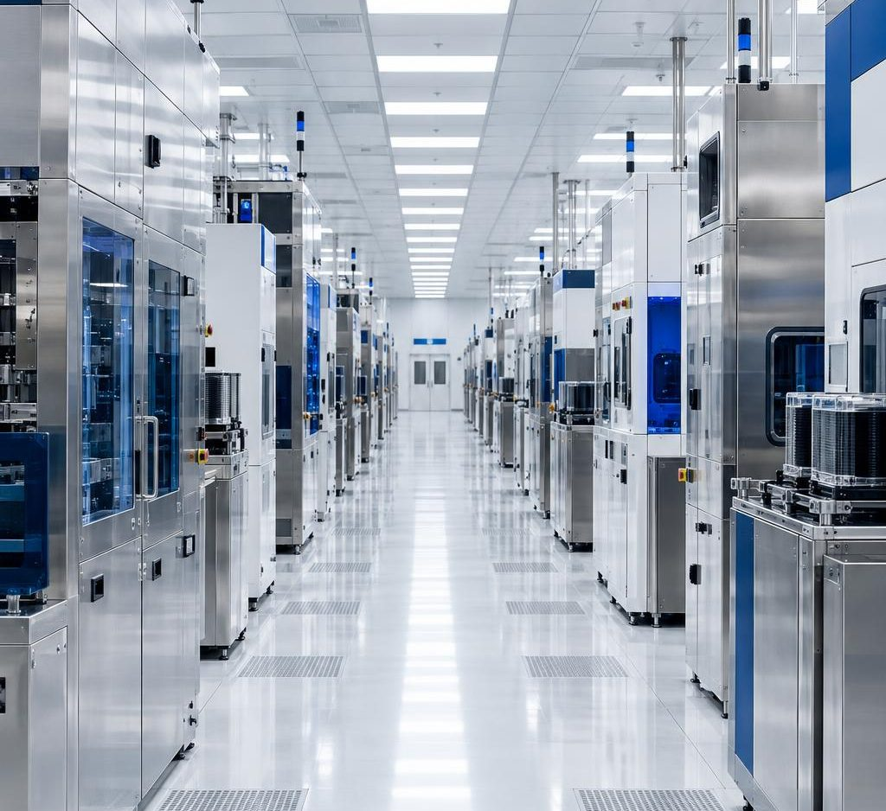
Microsoft
AI TOKENOMICS / EXECUTIVE BRIEF
Approve a measured pilot—not a promise
Days 1–30
Baseline
FinOps: reconcile bills; confirm access.
Days 31–60
Controlled test
Engineering: test one workload.
Days 61–90
Value validation
Finance + BU: approve changes; verify bills.
Decision today: name a BU sponsor, provide 90 days of spend data, and authorize a bounded pilot.
Source: proposed 90-day validation plan; timing is illustrative.
Michael Yaacoub | Sr Solution Engineer
13
Notes:
Illustrative 90-day plan, not a delivery commitment. Gate 1: agreed bill/usage reconciliation coverage and access review. Gate 2: workload-specific quality, latency and safety acceptance thresholds set by owners, not assumed here. Gate 3: Finance confirms realized billed savings net of incremental operating cost and one-time costs. Missing inputs: actual invoices and usage, workload mix, licenses/capacity, committed discounts, telemetry retention, traffic and quality baselines. Recommendation is to validate before scaling, not approve a guaranteed ROI.
Header uses an editable reconstruction of the Microsoft four-square mark and wordmark, not a supplied official logo asset.
Visual inspection note: The four Microsoft logo colours are intentional branding, not extra data-series colours. The measured card/text/arrow left edges include diagram routing lanes and card insets. Mixed-size node paragraphs and the engine's trailing blank paragraph can inflate estimated text-fit warnings; actual line placement is checked in the final rendered slides. The business cover uses a deliberate flat text panel beside a photograph.
Cleanroom photograph-style image is generated, not an actual customer facility.
Header uses an editable reconstruction of the Microsoft four-square mark and wordmark, not a supplied official logo asset.

Slide 14
Microsoft
AI TOKENOMICS / EXECUTIVE BRIEF
Make the financial assumptions auditable
Planning input / result | Lower spend | Planning case | Higher spend
AI consumption / month | $1,000,000 | $5,000,000 | $10,000,000
Gross savings / month | $230,880 | $1,154,400 | $2,308,800
Platform cost / month | $50,000 | $100,000 | $150,000
Net savings / month | $180,880 | $1,054,400 | $2,158,800
Net annual run-rate | $2,170,560 | $12,652,800 | $25,905,600
One-time setup | $300,000 | $600,000 | $900,000
Year-one net after ramp | $1,524,240 | $10,321,200 | $21,542,400
Gross = S × (1 − .88 × .92 × .95) | Year one = 10.5 × gross − 12 × platform − setup
Illustrative planning assumptions — not Micron spend, Microsoft pricing quotes, or guaranteed savings
Source: illustrative model. Dollars USD; savings are not verified customer economics.
Michael Yaacoub | Sr Solution Engineer
14
Notes:
Illustrative planning assumptions — not Micron spend, Microsoft pricing quotes, or guaranteed savings. Sequential residual levers are 12%, then 8%, then 5% = 23.088% combined, not 25%. Monthly net = gross−platform cost; annual run-rate=12×monthly net. Ramp gross realization: months 1/2/3 =25%/50%/75%; months4–12=100%, equivalent to 10.5 months. Platform charged all 12 months. Setup paid in year one. Planning break-even baseline at $100k monthly platform cost is $433,125.43/month; assumes lever realization and no setup recovery. Platform envelope includes Fabric, APIM, Log Analytics/App Insights, Blob/Cosmos, application hosting, Foundry inference, Power BI serving/licensing and operations allocation. It is not a SKU quotation. Existing licenses, capacity headroom, discounts, commitments, retention and traffic can materially change incremental cost and realized savings. Productivity and avoided incidents excluded. Scenarios change spend scale only—not likelihood.
Header uses an editable reconstruction of the Microsoft four-square mark and wordmark, not a supplied official logo asset.
Visual inspection note: The four Microsoft logo colours are intentional branding, not extra data-series colours. The measured card/text/arrow left edges include diagram routing lanes and card insets. Mixed-size node paragraphs and the engine's trailing blank paragraph can inflate estimated text-fit warnings; actual line placement is checked in the final rendered slides. The business cover uses a deliberate flat text panel beside a photograph.

Slide 15
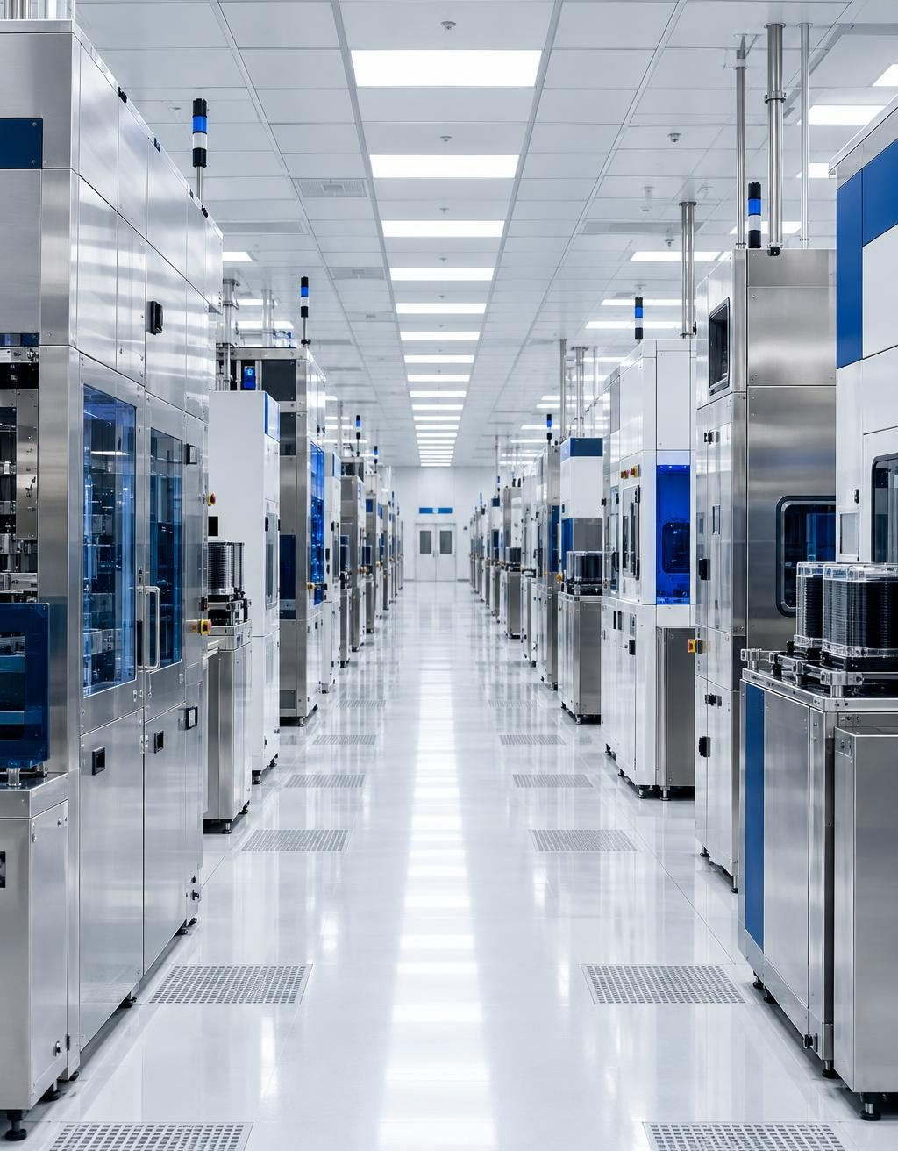
Microsoft
AI TOKENOMICS / EXECUTIVE BRIEF
Separate evidence from planning assumptions
Repository concept
Usage facts, price provenance and ML outputs.
Not production-validated.
GitHub: FabricIQ-FoundryIQ-CostOps-Docs
Fabric integration
Delegated tool access and observability.
Validate preview limits before commitment.
Microsoft Learn: Fabric agent tool + observability
APIM monitoring
Gateway logs can reach Log Analytics.
Caller attribution requires configuration.
Microsoft Learn: APIM monitoring + log schema
Sources: repository and Microsoft Learn links in notes • Accessed September 2026.
Michael Yaacoub | Sr Solution Engineer
15
Notes:
Reader-facing source register:
1. Repository—Microsoft Fabric Multi-Cloud AI Tokenomics & FinOps Platform: https://github.com/csdmichael/FabricIQ-FoundryIQ-CostOps-Docs
2. Foundry Fabric data-agent tool integration (preview): https://learn.microsoft.com/en-us/azure/foundry/agents/how-to/tools/fabric
3. Foundry/Fabric data-agent observability (preview): https://learn.microsoft.com/en-us/fabric/data-science/fabric-data-agent-foundry-observability
4. Fabric IQ OneLake Catalog agents as tools (preview): https://learn.microsoft.com/en-us/fabric/data-science/data-agent-foundry-fabric-iq
5. Monitor Azure API Management: https://learn.microsoft.com/en-us/azure/api-management/monitor-api-management
6. ApiManagementGatewayLogs schema: https://learn.microsoft.com/en-us/azure/azure-monitor/reference/tables/apimanagementgatewaylogs
All business-case dollar figures and reduction rates are illustrative planning assumptions, not published customer results, Microsoft pricing quotes or guarantees. No claim Micron is a trillion-dollar enterprise. Header logo is reconstructed as editable shapes because no official asset was supplied. Charts on slides 9–10 use editable PowerPoint shapes; all architecture and waterfall marks are editable. The two native chart objects were replaced at user request after structural validation flagged their extension tags.
Header uses an editable reconstruction of the Microsoft four-square mark and wordmark, not a supplied official logo asset.
Visual inspection note: The four Microsoft logo colours are intentional branding, not extra data-series colours. The measured card/text/arrow left edges include diagram routing lanes and card insets. Mixed-size node paragraphs and the engine's trailing blank paragraph can inflate estimated text-fit warnings; actual line placement is checked in the final rendered slides. The business cover uses a deliberate flat text panel beside a photograph.
Cleanroom image is generated illustrative art.
Header uses an editable reconstruction of the Microsoft four-square mark and wordmark, not a supplied official logo asset.

